Slide 1


Day 25
contact@anubhavtrainings.com
ABAP RESTFUL APPLICATION PROGRAMMING

Slide 2

Agenda – Day 25
Behavior Definition – Business Object Behavior Definition
Why we need Behavior Definition
Create Behavior Definition on top of Root Entity
C-R-U-D Implementation in Unmanaged Scenario

Slide 3
Behavior Definition
A Business Object BDEF is an ABAP Repository object (just like Tables, classes, FM, Programs).
This BDEF determines the behavior of an BO in context of RESTful ABAP programming. In simple words, what are all the different operations our BO can do like create, update, delete..
This is created using BDL (Behavior definition Language)) and comprises modeling capability aspect of BP node for e.g. CRUD, actions, local between parent child etc.
A BDEF always refers to a CDS Model. This reference results from the name equality with root entity,
Your CDS view name = BDEF Name
CDS View (root)
Business Object
Behavior Definition
Code is written in behavior pool, pool of local classes inside a global class
1 0..1
1
1
1..N
0..N
CDS Childs
Behavior Implementation
(M- option, U- Mandatory)

Slide 4
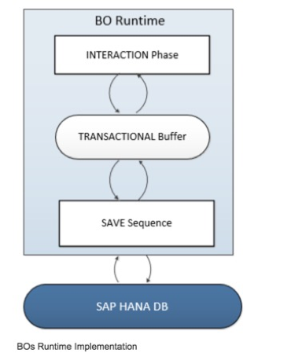
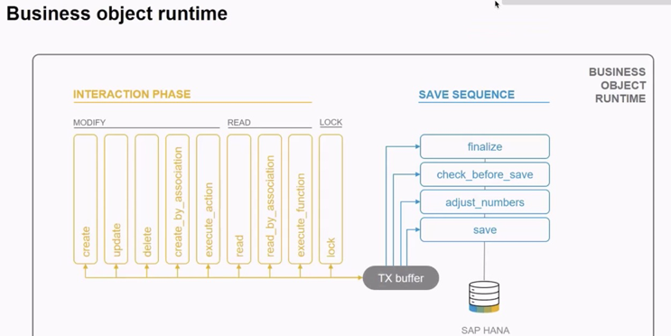
Business Object’s Runtime Implementation
The business object runtime mainly consists of two parts: The first part is the interaction phase where a consumer calls the business object operations to change data and read instances with or without the transactional changes. The business object runtime keeps the changes in its internal transactional buffer which represents the state of the instance data. This transactional buffer is always required for a business object. After all changes were performed, the data can be persisted. This is realized with the save sequence.

Slide 5
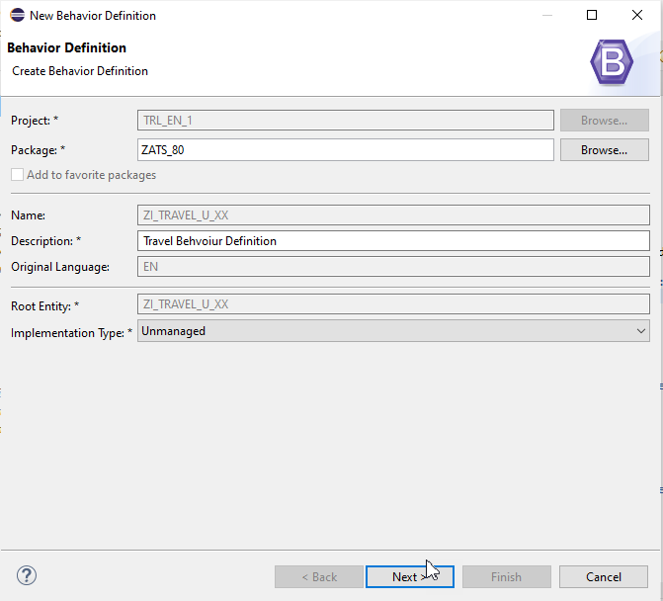
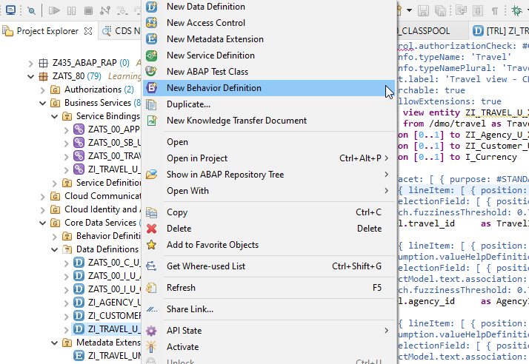
Implementing of Behaviour Definition

Slide 6
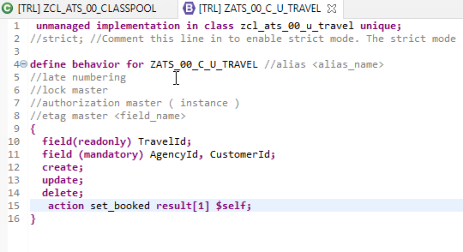
Exercise
Behaviour Definition

Slide 7

End of Day 25
Trainer: Anubhav Oberoy

Slide 8

Trainer: Anubhav Oberoy

Slide 9
THANK YOU
If you cannot do
great things, do small things in a great way.
Anubhav Oberoy
https://www.anubhavtrainings.com

Slide 10


We’re committed to empower you to be
Most Desirable Resource
through powerful training solutions.
We build the workforce of the future.
250+
Corporate Clients
30,000+
Learners Trained
25000+
Learners Placed
FREE WEBINARS
Sign up for free webinars with industry experts every fortnight!
Enroll Now!
Contact us today!
https://anubhavtrainings.com/

Slide 11




More from AnubhavTrainings.com

